Slide 1
K-12 Spending and Success
An Analysis
Sahar Alaei
Analiza Asuncion
Ben Pollock
Ana Saavedra
Eric Wetzel

Slide 2
Research Questions
>>
Do students in states with high education expenditures per student perform well on standardized tests?
>>
Do students in states with high education expenditures graduate at high rates?
>>
Is there a correlation between the size of a school district and its expenditures?
>>
Is there a spending “sweet spot,” a point beyond which additional investments in education do not affect student performance?

Slide 3
Data Gathering
>>
Initial exploration via Kaggle.com
>>
Expenditure Data U.S. Census Bureau LEA Finance Survey, 2015-2016 (National Center for Educational Statistics)
>>
Enrollment Data U.S. Census Bureau
>>
Test Score Data 4th/8th Grade Test Scores, 1990-2017 (National Assessment of Educational Progress)
>>
Graduation Data Adjusted Cohort Graduation Rate Report, 2015-2016 (U.S. Department of Education)

Slide 4
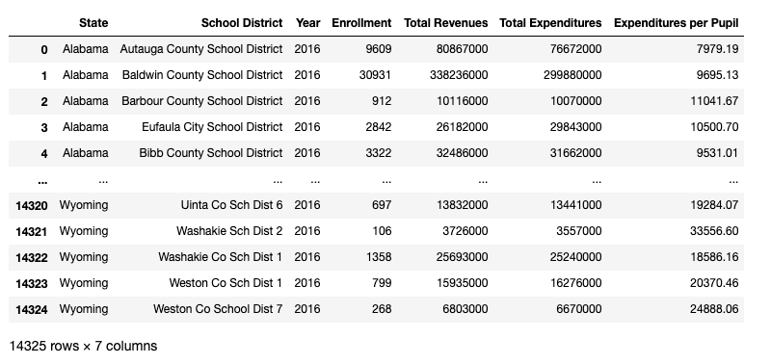
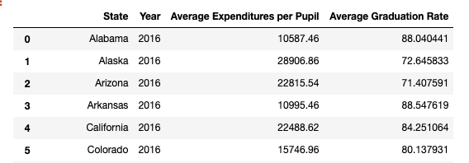
Data Cleansing
>>
Tools Used Microsoft Excel Python Pandas
>>
Steps Taken Merging, grouping, and sorting to align data
Data validation Computation of averages
>>
Problems and Solutions Use of notnull() to remove non-null, non-numeric test data Use of Excel formulas to locate medians of inconsistently formatted graduation rates

Slide 5
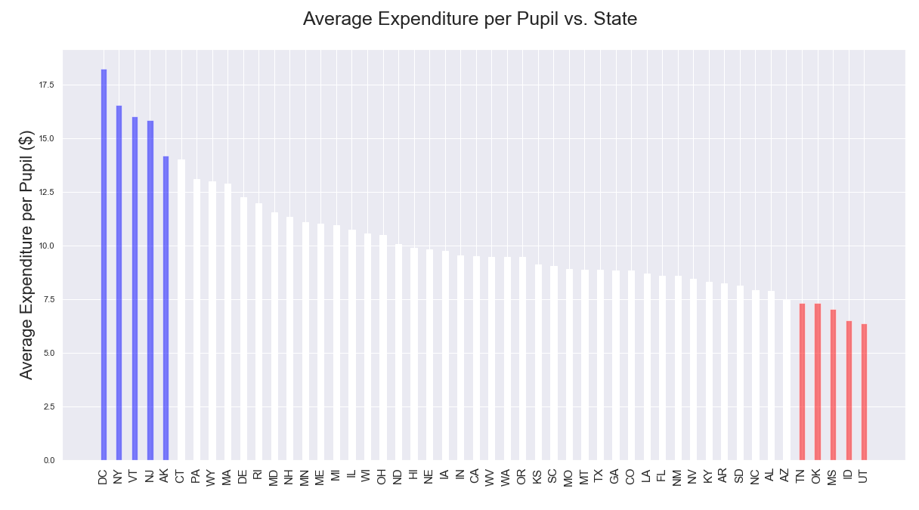
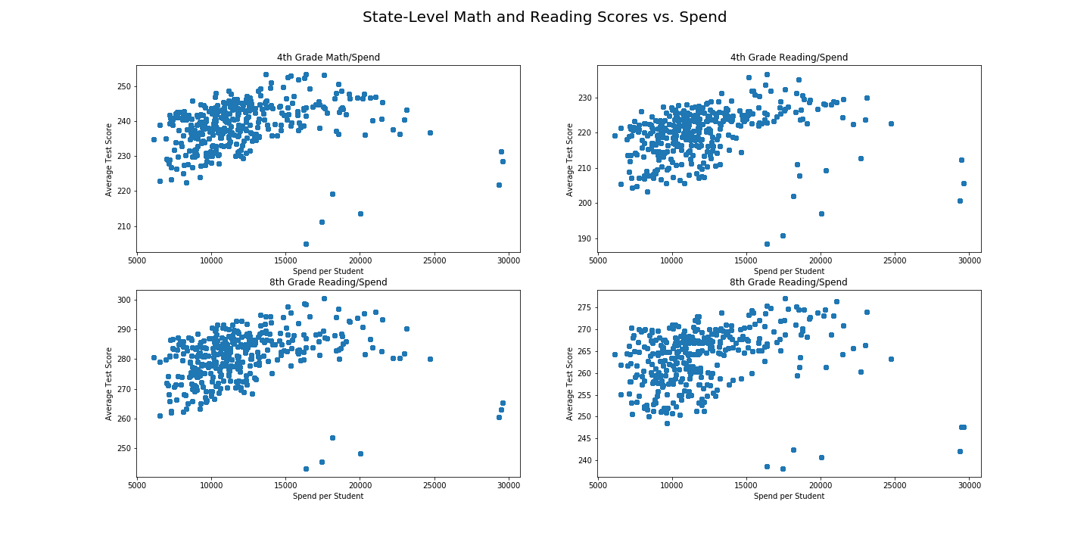
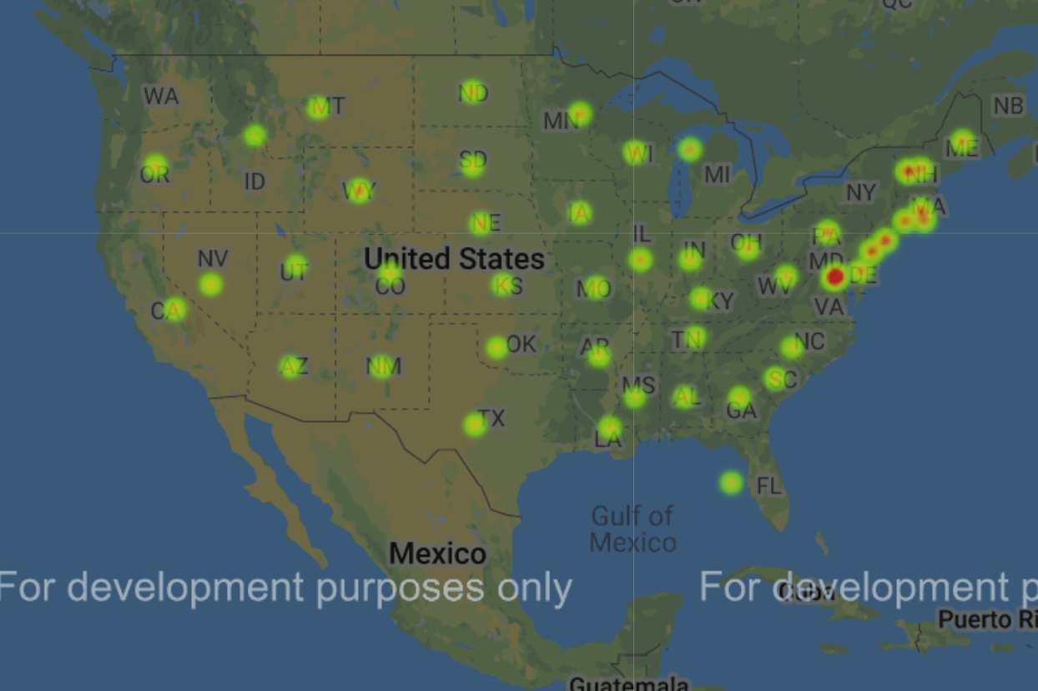
State Expenditures Per Pupil

Slide 6
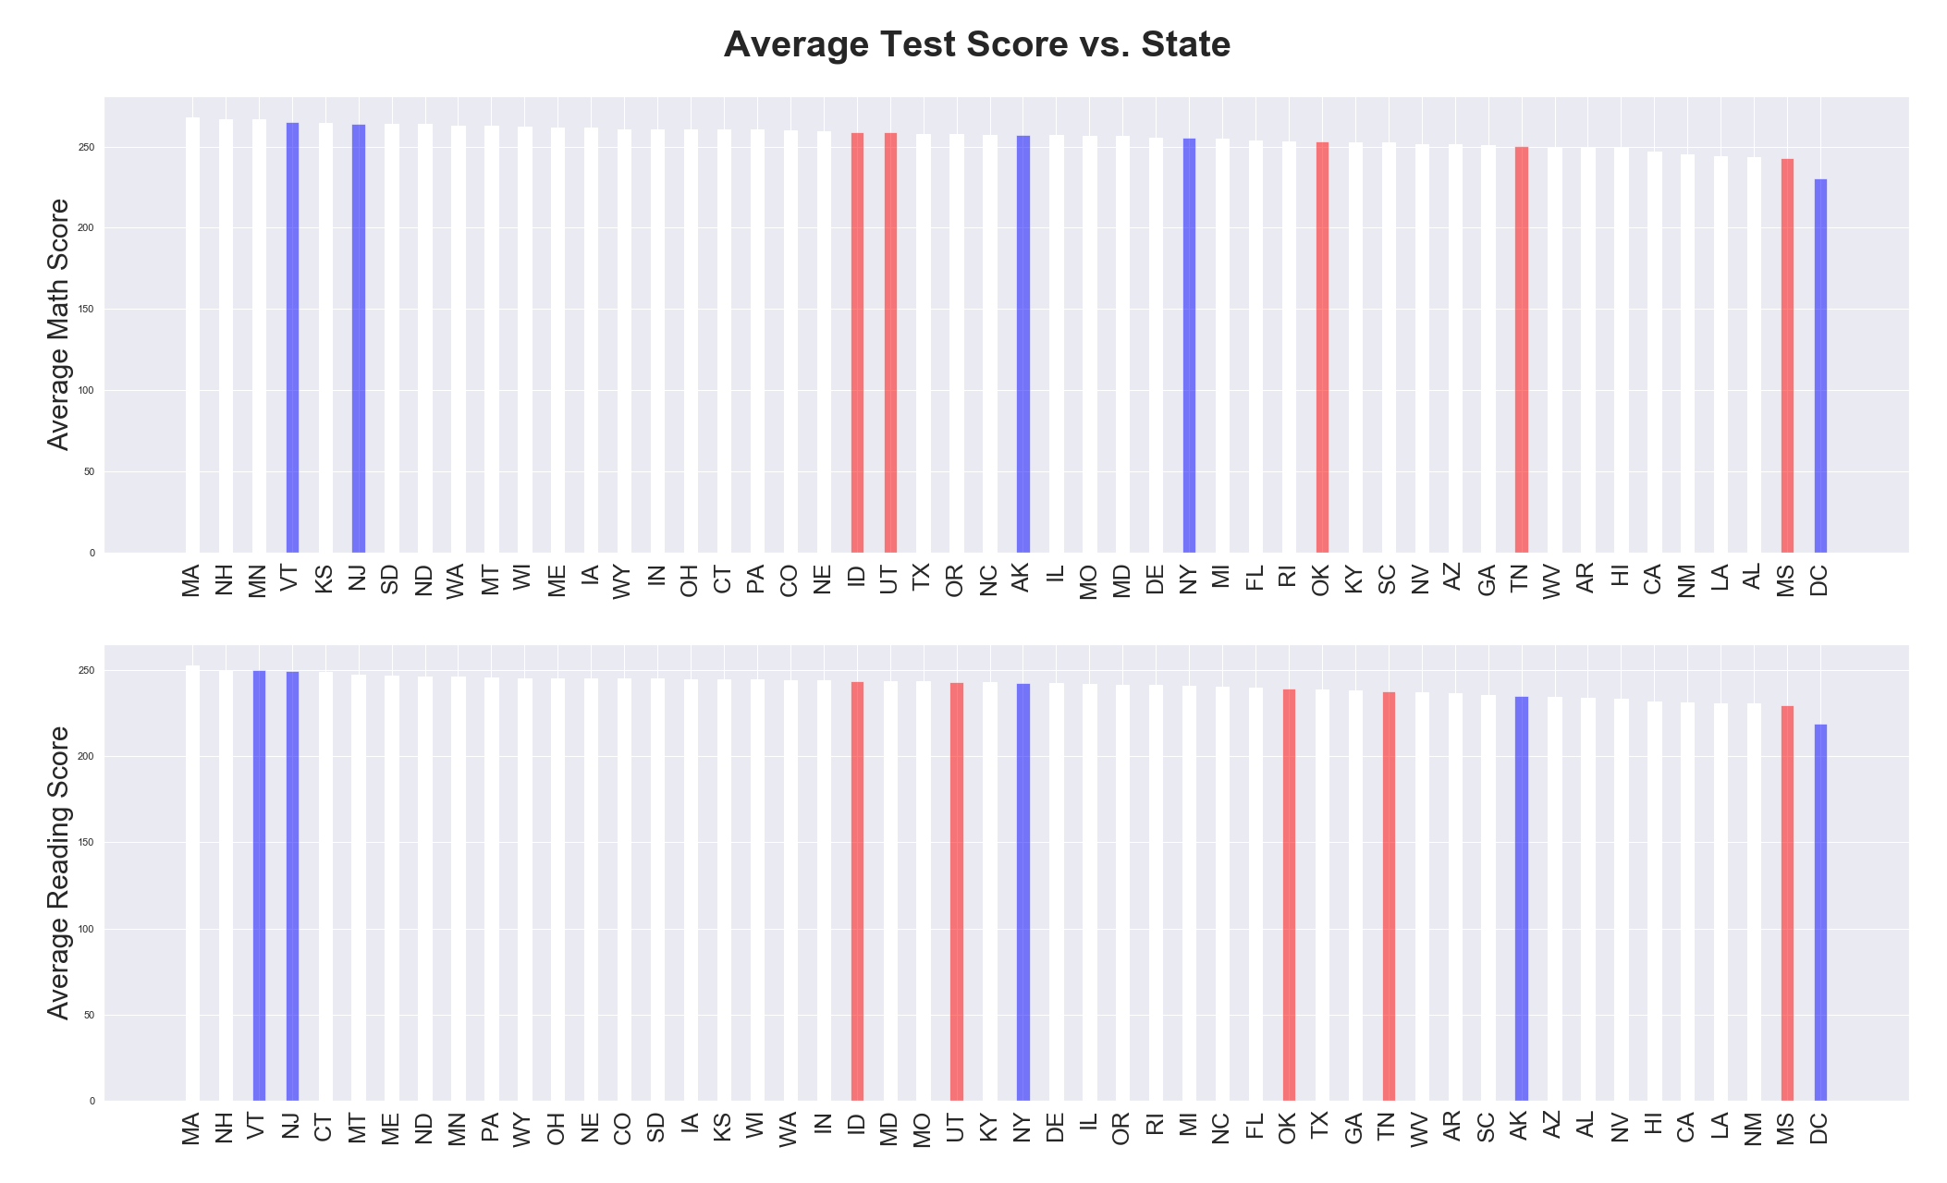
Average Test Scores by State

Slide 7
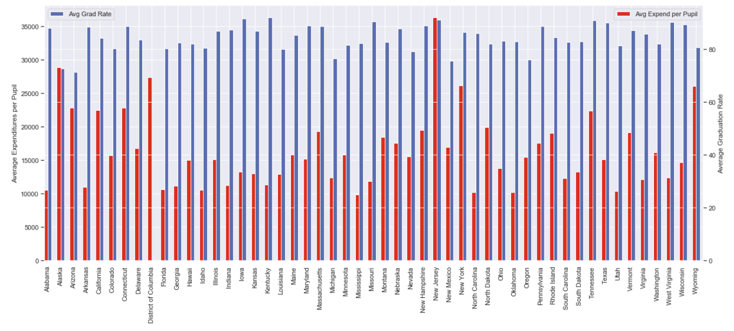
Average Expenditures and Graduation Rates by State (2016)

Slide 8
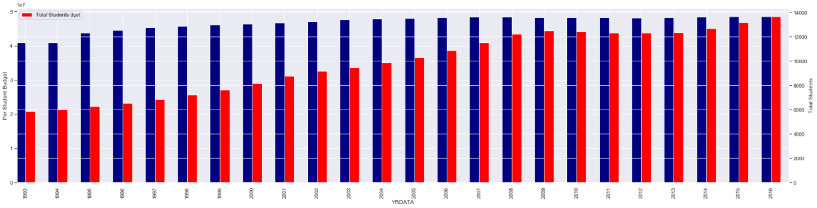
Nationwide Expenditures and Enrollment Over Time

Slide 9
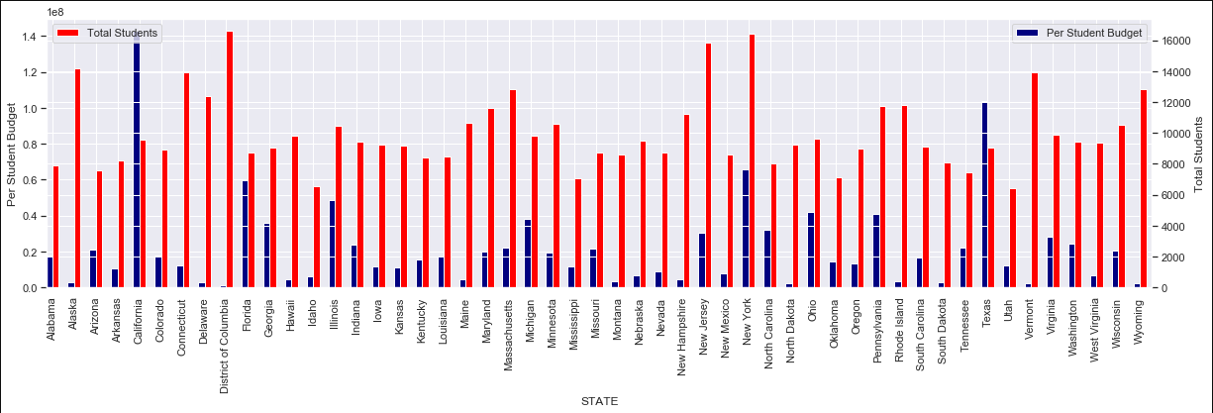
Expenditures and Enrollment by State (1993-2017)

Slide 10
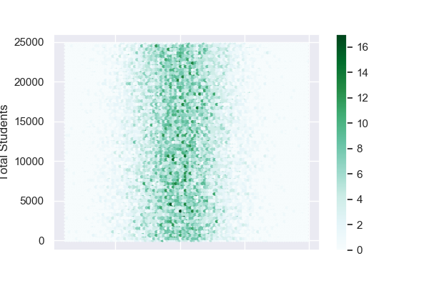
District Expenditure Levels vs. Enrollment

Slide 11
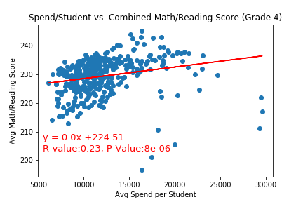
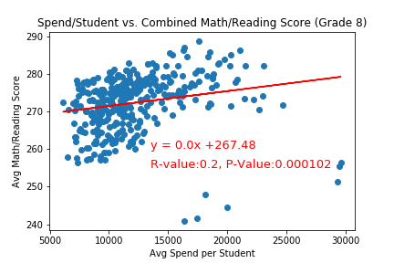
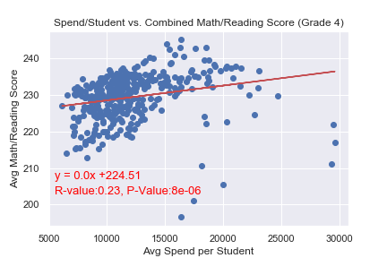
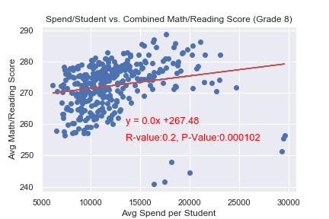
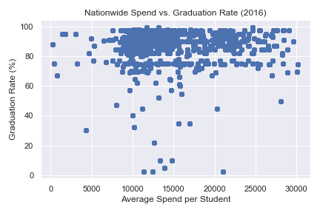
Expenditures vs. Graduation Rates and Test Scores

Slide 12
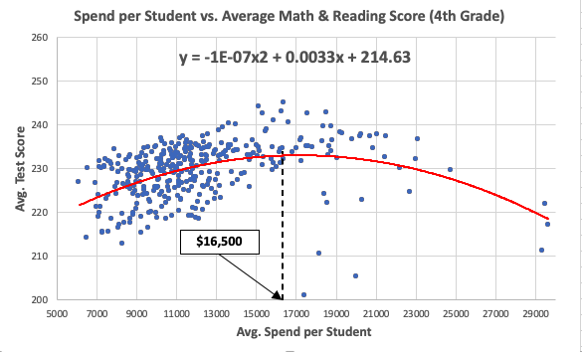
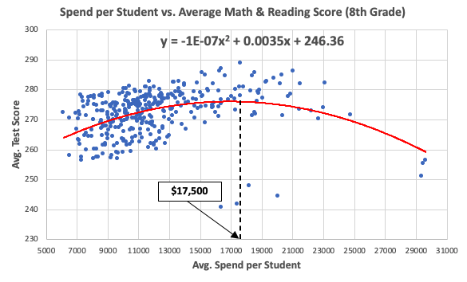
Expenditures vs. Graduation Rates and Test Scores

Slide 13
Conclusions
>>
There is a weak positive relationship between a state’s per-pupil expenditures and standardized test scores.
>>
There is no relationship between a state’s education per-pupil expenditures and graduation rates.
>>
There is no relationship between a district’s level of enrollment and its per-pupil expenditures.
>>
There is a spending “sweet spot”: $16,500 per pupil per year (4th Grade) and $17,500 per pupil per year (8th Grade).

